Slide 1
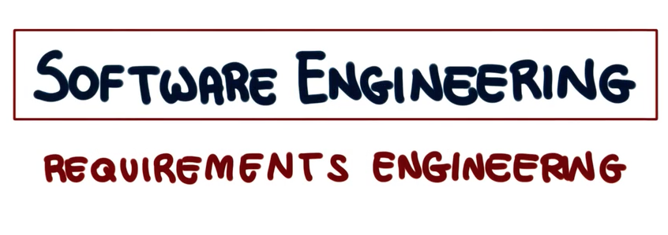

Slide 2
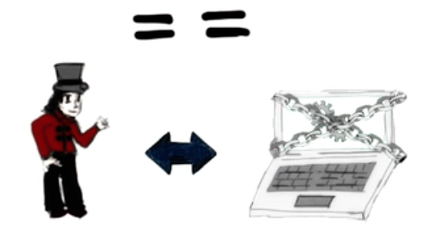
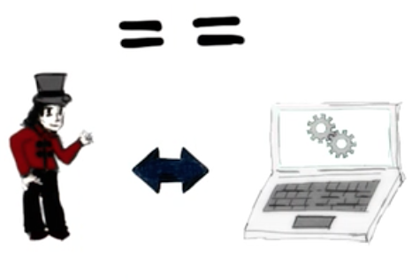

Requirements Engineering (RE)
=> Software Requirements Specification (SRS)
Notes:
Requirements engineering, which is also called in short, RE, is the process of establishing the services that the customer requires from the software system. In addition to that, requirements engineering also has to do with the constraints under which the system operates and is developed. Requirements engineering is a very important activity for several reasons. In particular, many errors are made in requirement specifications. So many errors are made because we don't do requirements engineering in the right way. And many of these errors are not being detected early. But they could be if we were to do RE in the right way. And, unfortunately, not detecting these errors can dramatically increase software costs. So that's the reason why requirements engineering is important, and why it is important to do it in the right way.
The final result of the requirements engineering process is a software specification that we also called SRS. It can say that the software requirements specification and requirements engineering, in general, should focus on what the system is intended to do, and not on the how it will do it. In fact, how the system do what it is required to do is something that we will discuss when we talk about design of a system .

Slide 3

Identifying Purpose = Defining Requirements
Sheer complexity of the purpose / requirements
Often, people don’t know what they want until you show it to them-Steve Jobs
Changing requirements
Multiple stakeholders with conflicting requirements
Notes:
So now, identifying the purpose of a software system means defining the requirements for the system. And Identifying the purpose of the software and defining its requirements is very hard. Why is it so hard?
First of all, the purpose of most systems is inherently, extremely complex, so this has to do with the sheer complexity of the purpose of the requirements. Just think of how complex is the functionality provided by most systems. Second, it is hard, very hard to extract from humans this purpose and make it explicit. So, paraphrasing a famous quote from the late Steve Jobs, often people don't know what they want until you show it to them. It's hard to figure out what people really want. Third, requirements often change over time. Customers change their mind. Designing and building a system raises new requirements. So for many reasons requirements tend not to be stable, tend to evolve. And that, of course, makes it harder to collect them. Finally, for any realistic system, there are many stakeholders and they often have conflicting goals and requirements. So for all these reasons, it is very, very difficult to perform requirements engineering in an effective way.

Slide 4
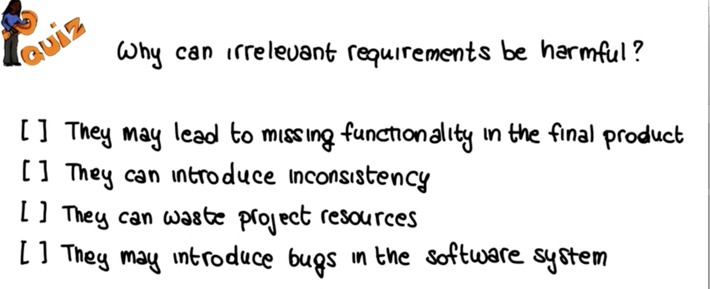
Notes:
Why can irrelevant requirements be harmful? Why is that a problem to have irrelevant requirements? So here, I'm giving you four possible answers. And I'd like for you to mark all that apply. Can irrelevant requirements be harmful because they may lead to missing functionality in the final product. Because they can introduce inconsistency. Because they can waste the project resources. Or because they may introduce bugs in the software system.

Slide 5
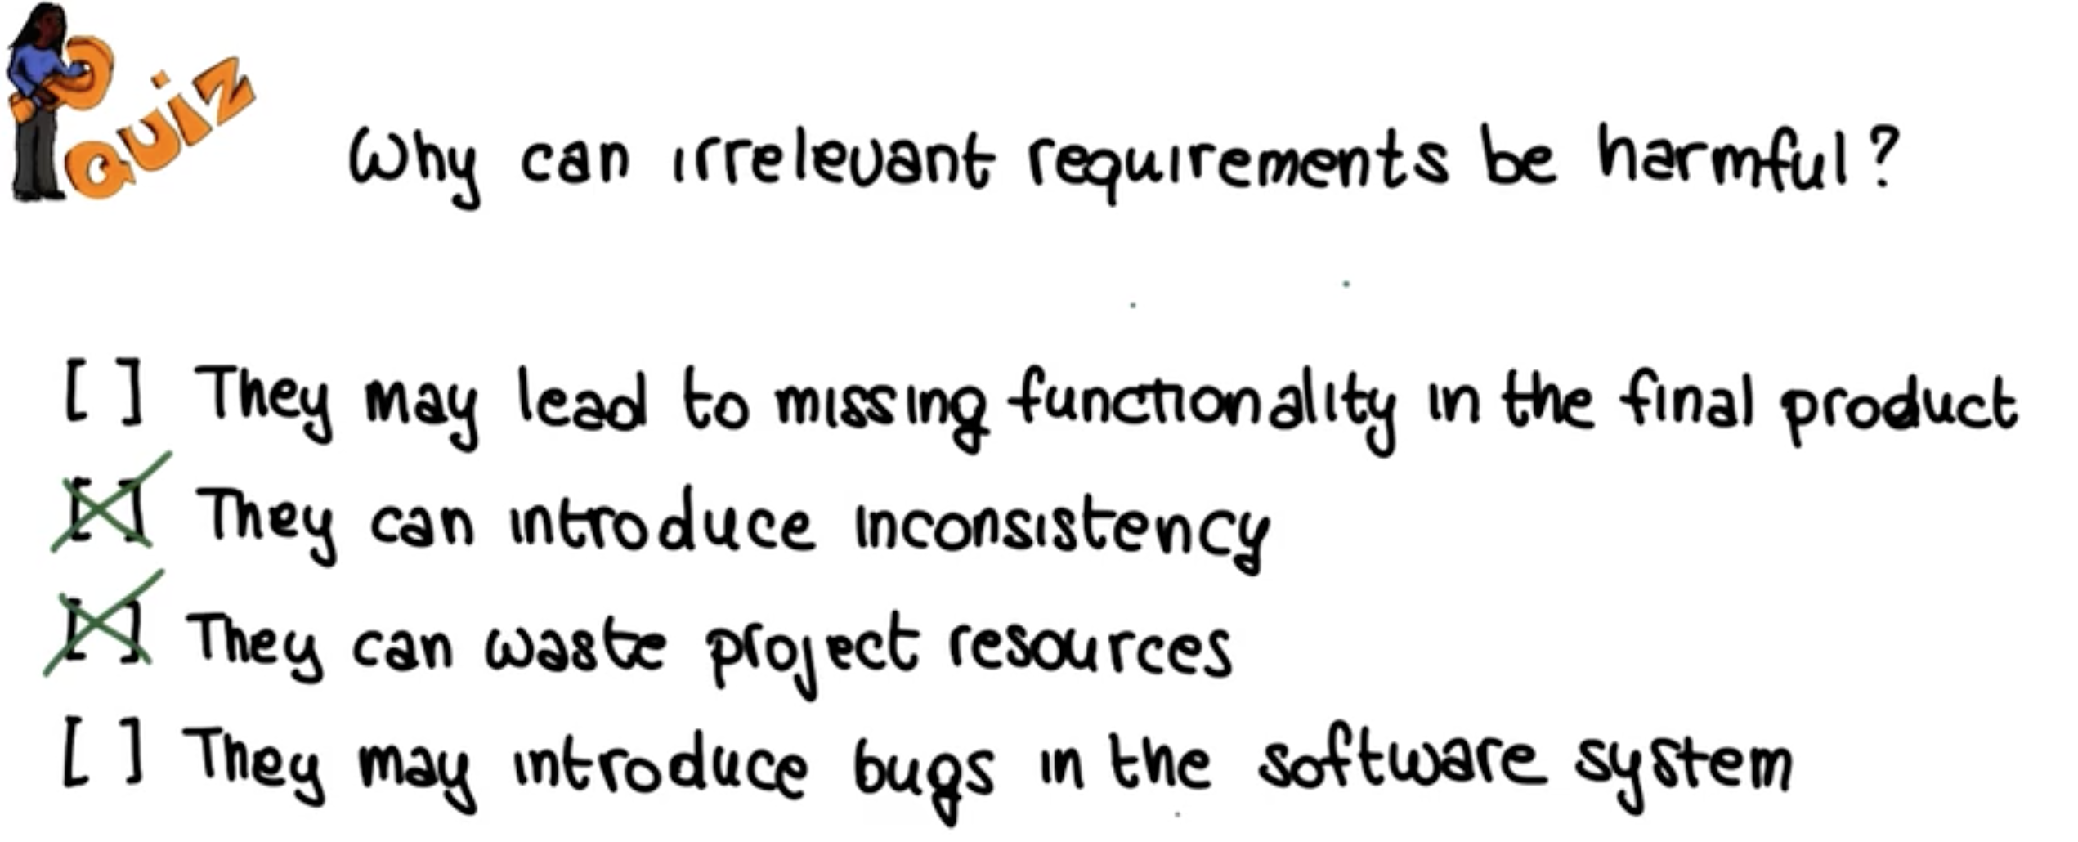

Slide 6
Definition of Requirements Engineering
Requirements analysis, also called requirements engineering, is the process of determining user expectations for a new or modified product. These features, called requirements, must be quantifiable, relevant and detailed.
Hence, RE acts as the bridge between the real-world needs of users, customers, and other constituencies affected by a software system, and the capabilities and opportunities afforded by software-intensive technologies
Notes:
Requirements engineering acts as the bridge between the real-world needs of users, customers, and other constituencies affected by a software system and the capabilities and opportunities afforded by software-intensive technologies. This is a long sentence, but also here, we can point out a few interesting and relevant points. Real-world needs, and the capabilities, and opportunities. So, what are these two parts telling us? They are telling us that requirements are partly about what is needed, the real-world needs of all these stakeholders. But they're also partly about what is possible, what we can actually build. We need to compromise between these two things. And, finally, I would like to point out this term constituencies, which indicates that we need to identify all of the stakeholders, not just the customer and the users, so anybody who is affected by a software system. It is very important to consider all of these actors. Otherwise, again, we'll be missing requirements, we'll be missing part of the purpose of the system and we will build a suboptimal system.

Slide 7

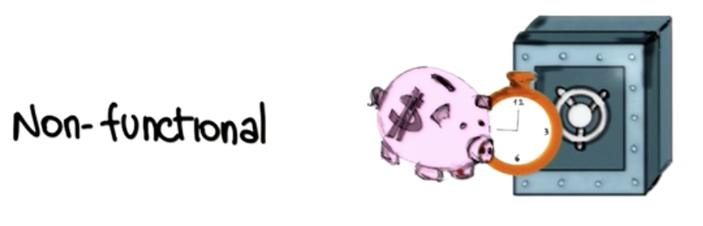
Functional and Non-Functional Requirements
Notes:
Among the requirement that we can collect from the application domain, we need to distinguish between two main types. Functional requirements and non-functional requirements. Functional requirements have to do with the functionality of the system, with what the system does with the computation. For example the elevator shall take people to the floor they select. That's a functional requirement, that has to do with the functionality of the system. Or for a very simple one, the system has to output the square root of the number pass as an input. So these kind of requirements have in general well defined satisfaction criteria.
Non-functional requirements, refer to a system's non-functional properties such as security, accuracy, performance, cost or, usability, adaptability, interoperability, reusability and so on. So, all these qualities that don't necessarily have to do with the functionality. And, unlike functional requirements, non functional requirements do not always have clear satisfaction criteria. For example, if we say that the elevator must be fast, that's a non-functional requirement. Right? It has to do with the speed of the elevator, which is a quality of the elevator. But, it, it's not clear how such a requirement could be satisfied. How could we tell whether the elevator is fast or not. So, what we need to do in these cases Is that we need to refine these requirements so that they become verifiable. For the example we might say that the elevator must reach the requested floor in less than seconds from the moment when the floor button is pushed. This is still a non-functional requirement, but is a verifiable one.

Slide 8
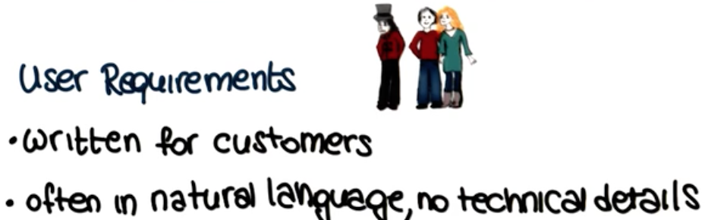
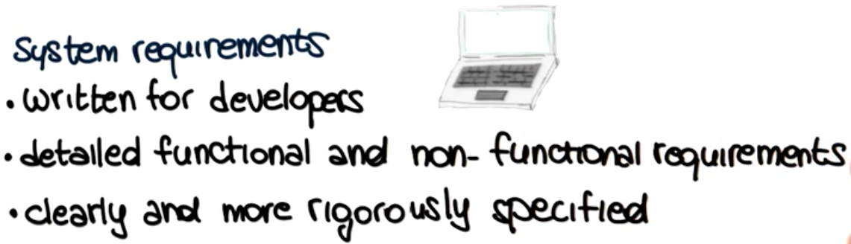
User and System Requirements
Notes:
Another important distinction, when talking about requirements, is that between user and system requirements. So, let's start with defining user requirements. Those are requirements that are written for the customers and they're often in natural language and they don't contain technical details. And the reason for that is that their purpose is to allow customers, stakeholders, to check that the system will do what they intended. So it's a way for the analyst, the developers, to communicate with the customers, with the stakeholders. System requirements, on the other hand, are written for developers. Contain detailed functional and non functional requirements which are clearly and more rigorously specified than the user requirements.
And the reason for this difference is that the purpose of the system requirements is to tell developers what to build. They must contain enough details so the developers can take them and use them to design and then develop a system.

Slide 9
User and System Requirements
User Requirement Definition:
1. The MHC-PMS shall generate monthly management reports showing
the cost of drugs prescribed by each clinic during that month.
System Requirements Specification:
1.1. On the last working day of each month, a summary of the drugs
prescribed, their cost, and the prescribing clinics shall be generated.
1.2. The system shall automatically generate the report for printing after
5.30 pm on the last working day of the month.

Slide 10
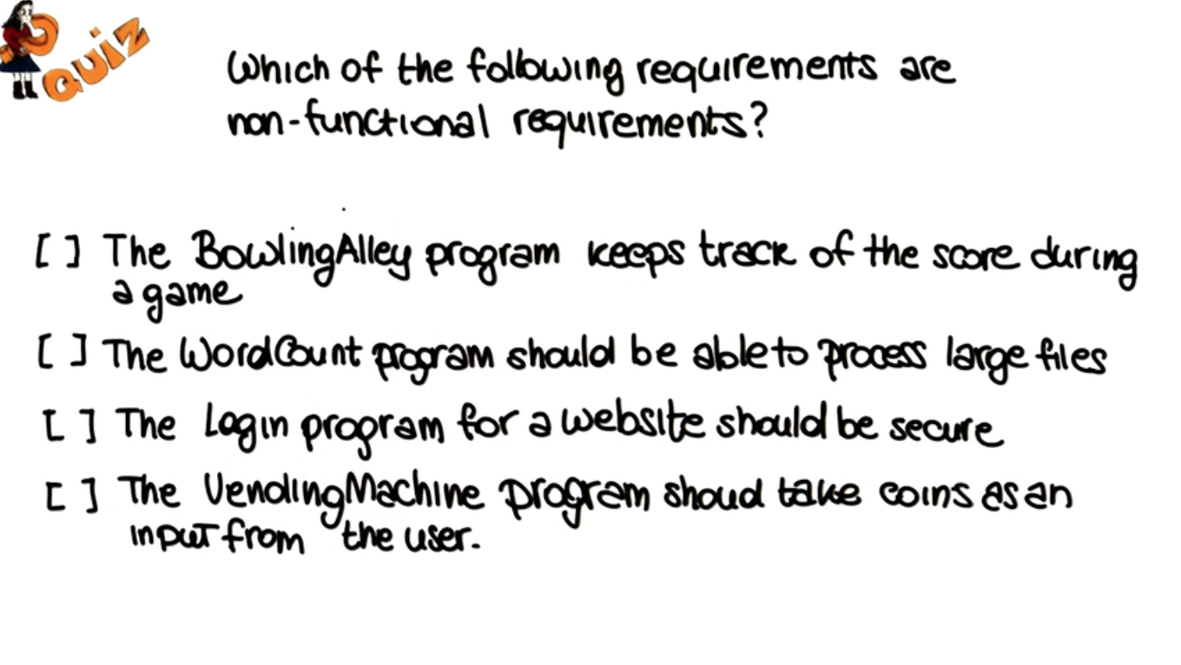
Notes:
After all these talking about requirements, let's have a small quiz, which of the following requirements are non-functional requirements? And here the first one says at the BowlingAlley program keeps track of the score during a game, the second one is that the WordCount program should be able to process large files. The third one is that the Login program for a website should be secure, and finally the last one says that the vending machine program should take coins as an input from the user. So, mark all the ones that are non-functional requirements, that don't refer to the functionality of the system.

Slide 11
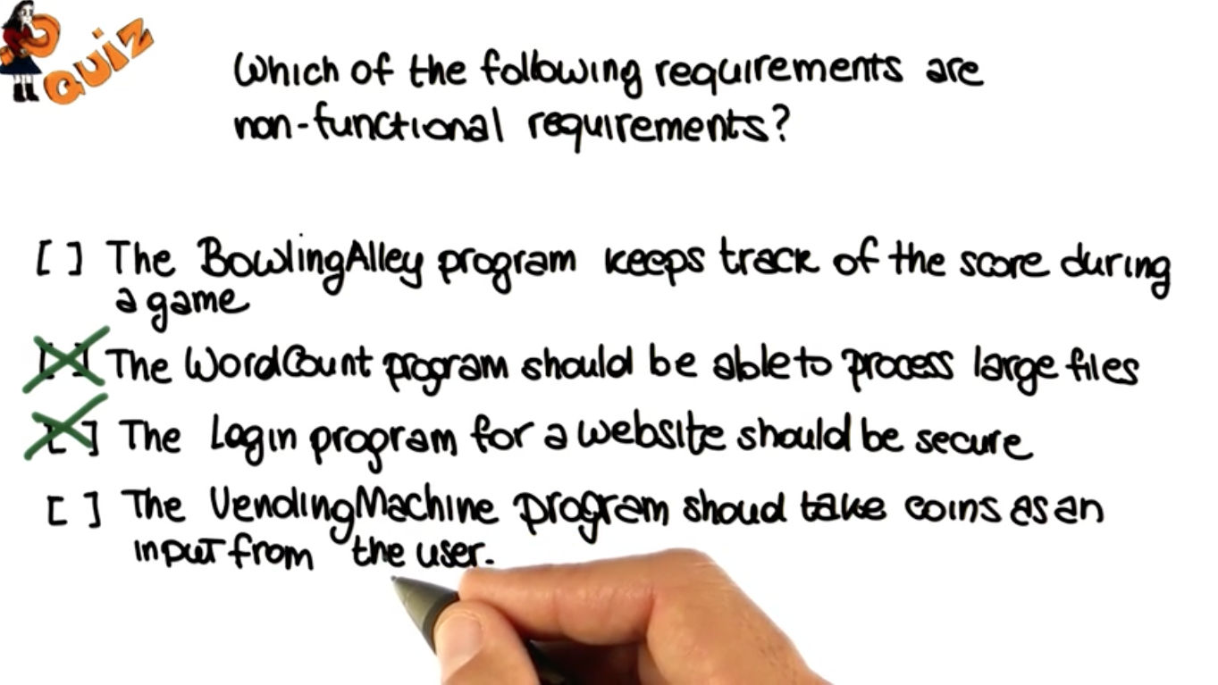
Notes:
So, the first requirement clearly refers to some specific functionality of the Bowling Alley system, because it talks about what the system has to do from a functional standpoint. So, it's definitely not a non-functional requirement. On the other hand, the fact that the Word Count system should be able to process large files, is telling us something not about the functionality of the system, but rather about its qualities. The fact that it has to be scalable, that it has to be efficient and so we can consider this to be a non-functional requirement. Similarly, the fact that the Login program for a website should be secure is definitely telling us something about the quality of the system that has little to do with its functionality. And so this is also a non-functional requirement. Finally, the fact that the Vending Machine program should take coins as an input from the user is telling us something about the functionality of the program and therefore, is a functional requirement.

Slide 12

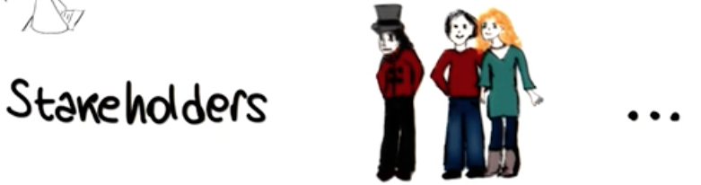
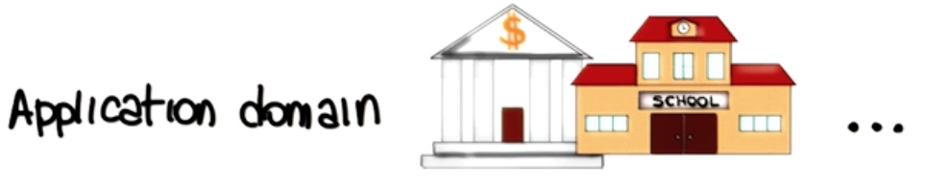
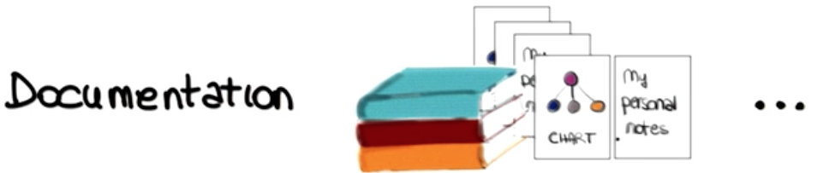
Notes:
Now we know what the requirements are and their main types, let's discuss where requirements come from and there are many possible sources .
The first one are clearly stakeholders, anybody who is effected by the system and its functionality. Customers, users, and so on.
The second typical social requirement is the application domain. For example, the fact that our software is running within a bank, or within a school. Why is the application domain a
social requirement? Well, because there are constraints that are characteristics of the application domain that will affect the functionality of the system.
For a simple example, just think about regulations. So banking regulations and school regulations in these cases. Those are things that might affect the functionality of our system and, therefore, that may become part of our requirements.
And, finally, documentation can be an additional source of requirements. For example, notes, papers, manuals, books. So everything that refers to
the functionality of the system that we're going to build.

Slide 13
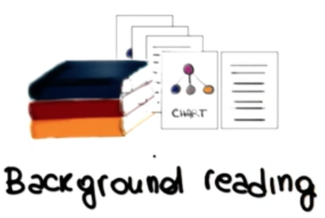
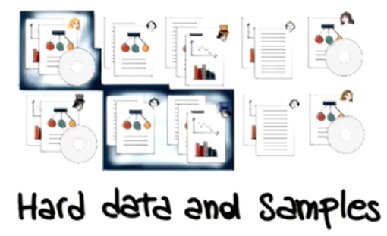

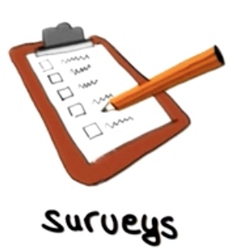
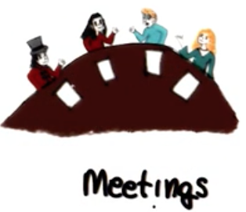
Traditional Techniques for Requirement Elicitation
Notes:
To cover the problems of eliciting requirements, many different techniques have been proposed. So here some of most traditional techniques for requirement elicitation and these techniques can be used separately or combined.
A first technique is called background reading. And, this technique involves collecting information by reading existing documents such as company reports, organizational charts, policy manuals, job descriptions, documentation of existing systems and so on. And, this technique is especially appropriate when not familiar with organization for which the requirements are being collected. So you want to get some background before interviewing actual people. And one of the main lmitations of these kinds of approaches is that written documents might be out of sync and they often are out of sync with reality. It may contain many irrelevant details, so you may have to look at a lot of materials to extract enough information.
The hard data and samples techniques consist in deciding which hard data we want to collect and choosing the sample of the population for which to collect such data. Hard data includes facts and figures such as forms, invoices, financial information, survey results, marketing data, and so on.
Interviews are another typical approach for requirement elicitation. Interviews can be structured in which case there is an agenda of fairly open questions or they can be open ended in which case there is no preset agenda and the interview is more of a conversation. On the positive side, interviews can collect a rich set of information because they allow for uncovering opinions . Moreover, they can probe in depth through follow up questions. On the more negative side, interviewing requires special skills that are difficult to master and require experience. And it is not enough to collect a lot of information. If this information is hard to analyze or even irrelevant, it might become useless. So you need to know how to conduct an interview in order to take advantage of these techniques.
Surveys can also be extremely useful for gathering new requirements because they can quickly collect information from a large number of people. Moreover, they can be administered remotely. For example, by email, through the web. On the other hand, surveys tend to severely constrain the information that the user can provide and might miss opportunities to collect unforeseen, relevant information.
Finally, meetings are generally used for summarization of findings and collection of feedback, so as to confirm or refute what has been learned.

Slide 14
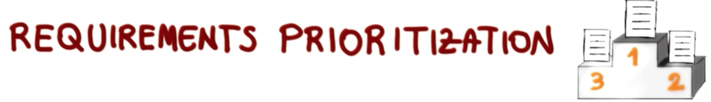

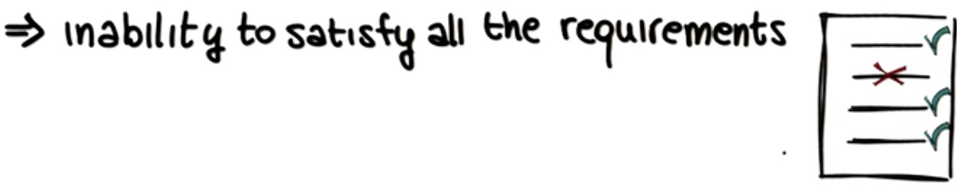
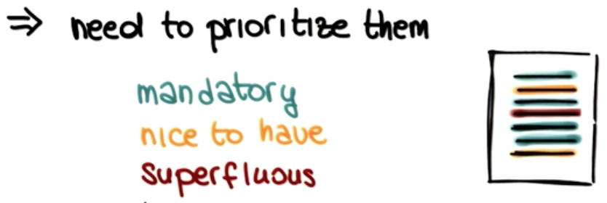
Notes:
Sometimes We might realize that the resources available for the project are not enough to satisfy all of them.
For example, there's not enough time, not enough money, not enough manpower. And therefore, there are some requirements that we won't be able to satisfy. In these cases, we must prioritize our requirements, by classifying them in one of three classes.
The first class is mandatory requirements, and these are the requirements we must satisfy.
Then there are the nice to have requirements that are the ones that we will satisfy if resources allow.
And finally, there are the superfluous requirements, and those are the requirements that
we're going to keep around, but that we're going to postpone. For example, we might decide
to satisfy them in the next release.

Slide 15
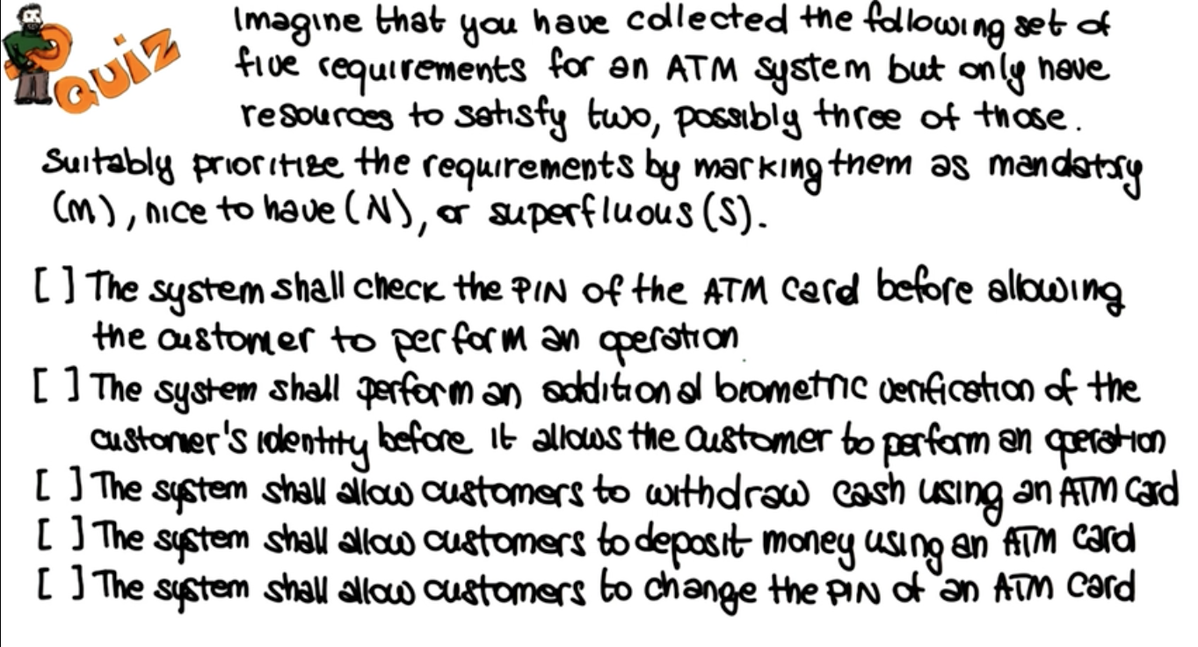

Slide 16
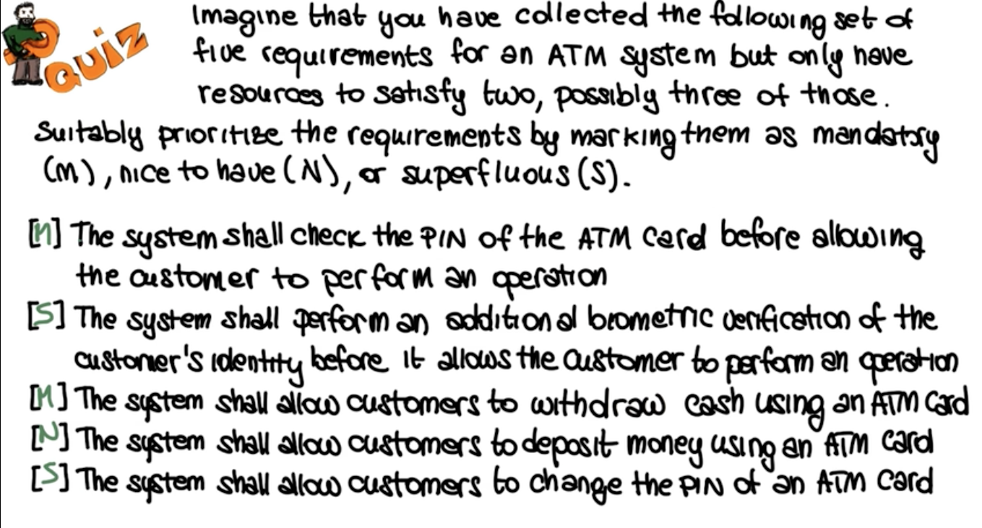
Notes:
Looking at the requirements, and knowing that we have only two
that we can satisfy for sure, it makes sense to first mark
as mandatory the ability to withdraw cash, which is the most typical
use of an ATM machine. We are therefore going to mark this requirement
with an M, for mandatory. It also makes sense to mark as
mandatory the fact that the ATM system checks the PIN of the
card being used by the customer, as that's the typical level of
security that the customer would expect,
therefore we're going to mark as mandatory
also the first requirement here. And of course we
could also perform biometric verification, but based on our knowledge
of the domain, it seems like that should be
an additional verification, rather than the main and only verification
for the system. We will therefore mark it superfluous.
That is something that we can postpone until a later
release, the second requirement. Finally,
another typical operation that customers
perform at ATM machines is depositing. Whereas changing an ATM
card's PIN is not such a common operation. We'll therefore mark
it nice to have this fourth requirement and as superfluous, the
last one. So at the end, what we have is that
we have two mandatory requirements which are the two that we can
satisfy for sure. One, nice to have the requirement, which is
the possible third requirement which we might have time to satisfy. And
the other two that are marked as superfluous, as something that
we might do later, for example in a subsequent release. And of
course there is something subjective in these answers. But
again, based on our knowledge on our understanding of
the domain, these are the one that makes more
sense for an ATM system as we know it.

Slide 17
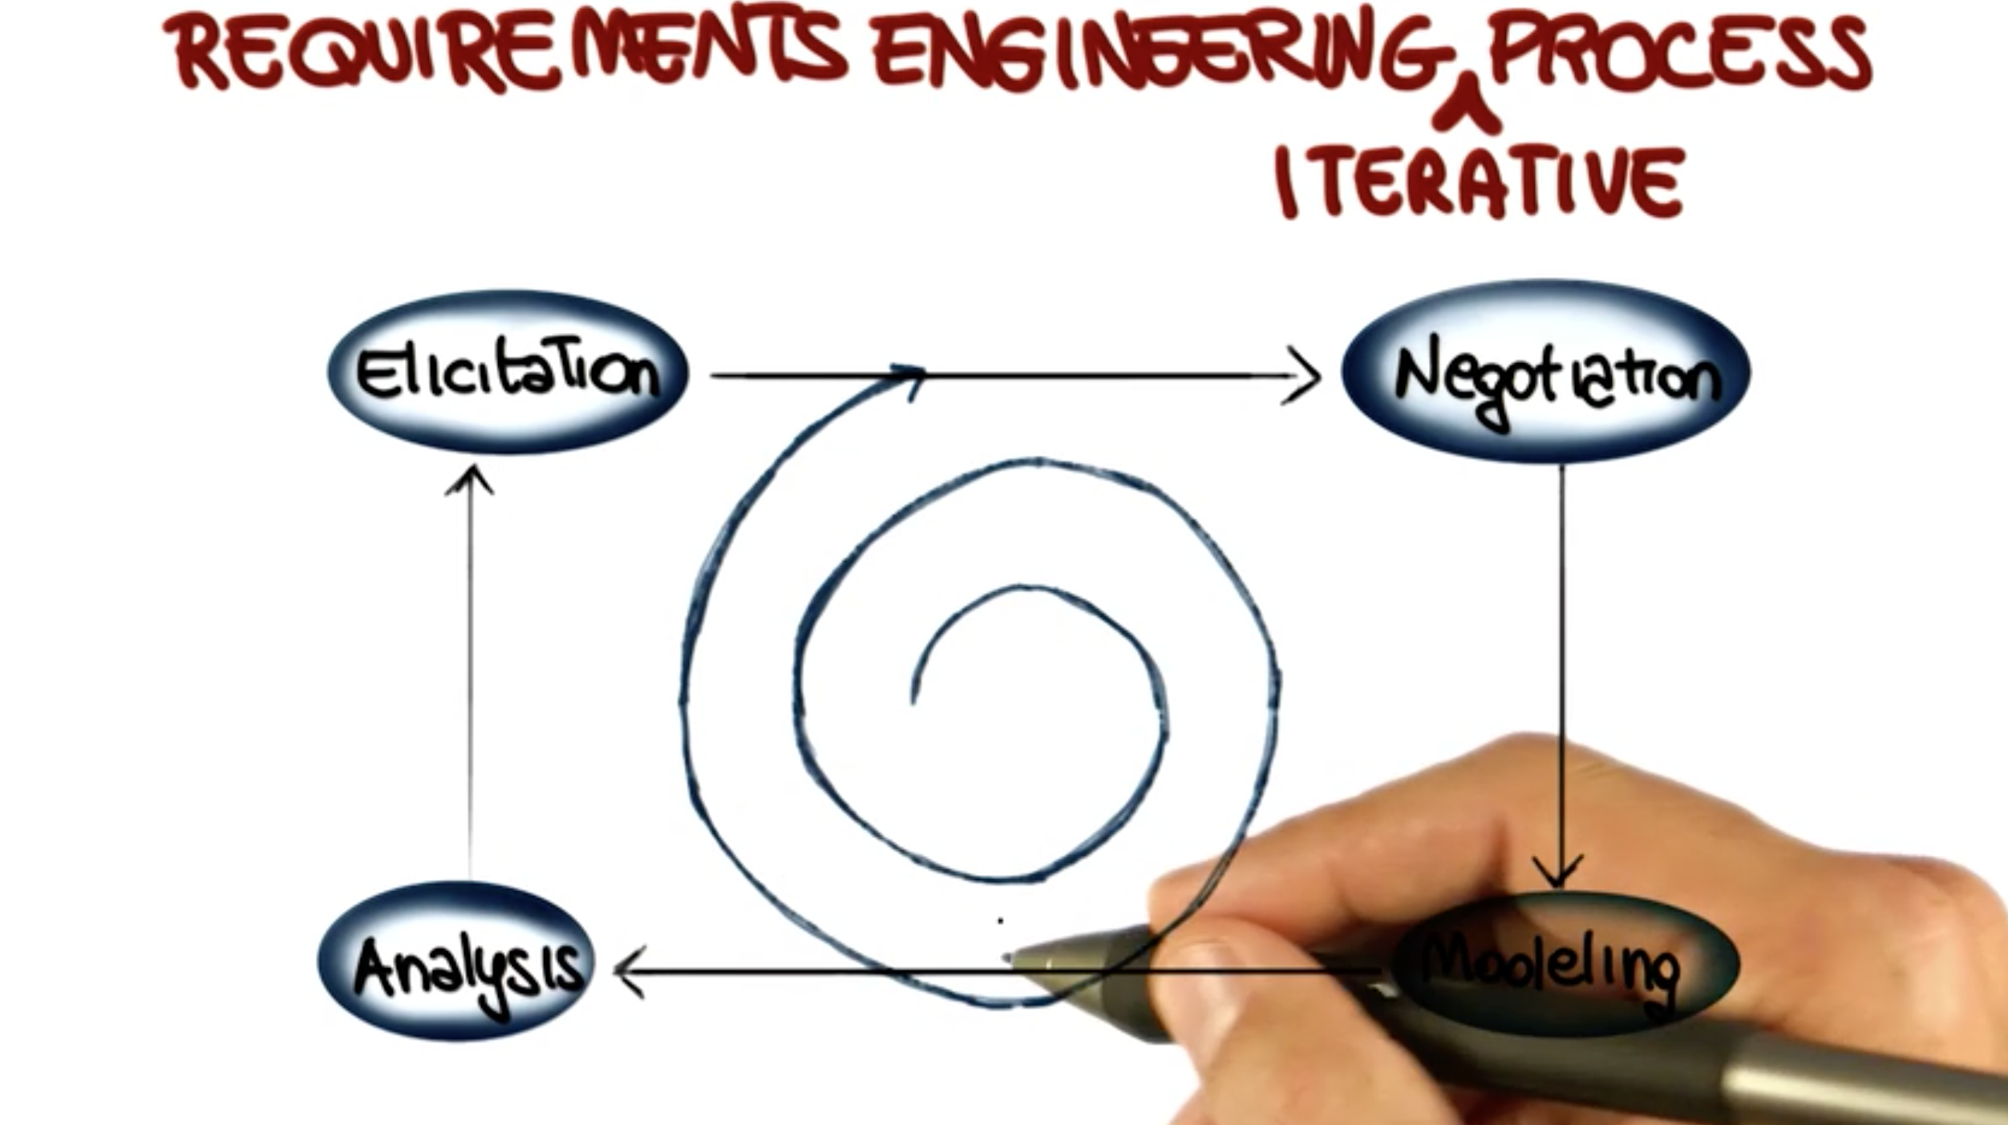
Notes:
Let's now discuss how a requirements engineering process actually works?
So, first of all, requirements engineering
consists of three main steps.
Elicitation of the requirements, in which we extract requirements from various sources.
Modeling in which we represent the requirements using one or more notations or formal reasons and analysis, in which we identify possible issues
with our requirements and there is actually a 4th step that we kind of mention
but not explicitly. And this is the negotiation that can happen between the stakeholders and the developers, during which
requirements are discussed and modified until an agreement is reached.
So if you want to think of this as a process, so as a sequence of steps, we can see
that we start from elicitation, We negotiate and refine this set,
then we model the resulting requirements. And finally, we analyze such requirements.
However, the process doesn't really stop here.
Why? Well, because as a result of the analysis, we might have to perform further elicitation. And so this
process is not really a sequential one, but rather an iterative process. So, in practice, we continue to iterate
over these four steps gathering a better and better understanding of the requirements at every iteration until we are happy with the settle requirement that we gather and stop the process.

